Slide 1
Index
1. Predictive Model
1.1. Data Sources
1.2. Results
2. Challenges
3. Iterating over the Predictive Model
4. AI Recommendation

Slide 2
Data Sources
outcome_baja
total_segundos_conversacion
immediately available after the call
Pre-call Data
Post-call Data
1 day
7 days
es_rellamada_24h
es_rellamada_agente_24h
LLAMADA_RETEN_24h
2 days
es_rellamada_72h
es_rellamada_agente_72h
llamada_reten_7d
times_retention
channel_ds
client_segment
port_in_operator_ds
service_type
tariff_ds
ultima_categoria_open_question
ultima_subcategoria_open_question
es_rellamada_48h
es_rellamada_agente_48h
LLAMADA_RETEN_48h

Slide 3
Data Sources Used in Models
Pre
0-day Model
Pre
+
Post
+
immediately available
+
1 day
1-day Model
Pre
+
Post
+
immediately available
+
2 days
2-days Model
Pre
+
Post
+
immediately available
+
7 days
7-days Model

Slide 4
Model Results
When the model says «yes», how often it is true?
When it is actually «yes», how often the model predicts «yes»?
Area under the curve plotted by each possible TP and FP rates
2 * Precision * Recall
Precision + Recall
 | Precision | Recall | F-1 Score | AUC
 | 0.25 | 0.28 | 0.25 | 0.69
 | 0.28 | 0.29 | 0.26 | 0.72
 | 0.26 | 0.32 | 0.26 | 0.72
 | 0.31 | 0.28 | 0.27 | 0.73
0-day Model
1-day Model
2-days Model
7-days Model
Models classify «yes» cases incorrectly almost ~70% of the time.
Models misclassify actual «yes» cases ~71% of the time.
A minimum of 40% F-1 score was expected to consider the model as valuable.
A minimum of 75% AUC score was expected to consider the model as valuable.

Slide 5
Model Results – Confusion Matrix
0-day Model
2-days Model
 |  | predicted
 |  | no | yes
actual | no | 8618 | 757
 | yes | 484 | 205
 |  | predicted
 |  | no | yes
actual | no | 8827 | 548
 | yes | 502 | 187
1-day Model
7-days Model
 |  | predicted
 |  | no | yes
actual | no | 8686 | 689
 | yes | 487 | 202
 |  | predicted
 |  | no | yes
actual | no | 8915 | 460
 | yes | 507 | 182

Slide 6
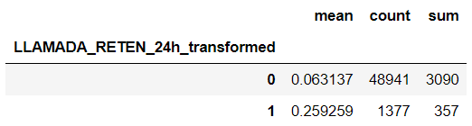
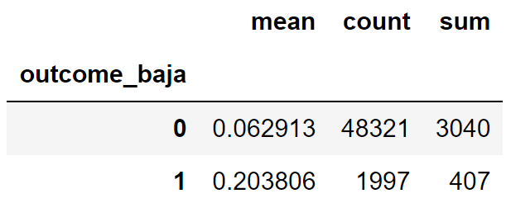
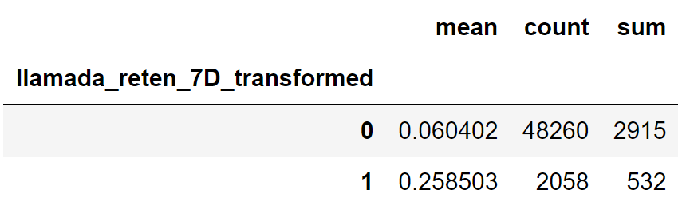
Challenges
1. Proxy Variables fail to classify correctly in ~75% of times:
2. Proxy Variables do not improve over time:
3. There are no other outcome sources that may be a possible proxy for the models.

Slide 7
Iterating over the Predictive Model
Creating new variables from the data available at MasMovil’s data center may improve the predictive model’s performance.
Disposition Tool:
Providing agents with a disposition tool to mark certain churn-related outcomes of the call (e.g. indicator of whether Retention number is provided to the customer on the call, indicator filled by agents if there is a churn intent shown by the customer on the call etc.)
CRM Data:
Customer Demographics – age, income level, marrial status, even family members’ providers
Payments – customers’ tariff avg value versus actual charges, late payments
Loyalty Indicators - # of years the customers have been with the company, length of time using same BTN, tariff changes/upgrades
BTN History:
Increasing frequency of care-complaint-dispute calls
Average duration of previous calls
Outcome labels from previous calls

Slide 8
AI Recommendation
Model Conclusion
In unbalanced datasets, we need to take F-1 score into account as it considers both False Negatives and False Positives at the same time. 27% of F-1 score is considered as insignificant, thus Afiniti will be blind on disconnects for 30 days. Consequently, Afiniti’s model data will be flagged incorrectly for 70% of the times which cannot guarantee a gain in production.
HOT Benchmark
In HOT, the earlier predictive model considered as «bad» even with a 45% F-1 score and 82% AUC score. The new predictive model has 55% F-1 score and 86% AUC score, labeling the 75-days disconnects good enough to predict whether today will produce gain at the end of the period.
AI Recommendation
It is recommended (i) if easy, to add features indicated in previous slide and build models again to see if there will be an improvement, (ii) if not, go by another metric that could be optimized.

Slide 9
Appendix
Model Pipelines (PY)
2. Model Results (HTML)
3. Single-Factor Analysis Results (JPG)

